Slide 1
On the Generation and Evaluation of Synthetic Data with GANs
Bauke Brenninkmeijer
2019

Slide 2
Outline
Introduction
Preliminaries
Related Work
Contributions
Results

Slide 3
On the Generation and Evaluation of Synthetic Data with GANs
Why synthetic data?
Very valuable in situations with restricted data flows (Government, Healthcare, Finance)
Why Generative Adversarial Networks (GANs)? Simple. They are the best for generating high dimensional data
Clear in domains of images, audio and video

Slide 4
Problem
Synthesizing tabular data with GANs is hard.
Different data types
Multi-modal data
Data can have long distance relationships
Evaluation of synthetic data is hard and performed inconsistent. What is ‘Good’ synthetic data? Different approaches in literature

Slide 5
Motivation
Realistic synthesized data is very valuable for any domain where flow of data is restricted due to privacy, like in governments, healthcare and finance.

Slide 6
Goal
The Goal is twofold:
Improve the State-of-the-art for tabular data generation with GANs
Create a improved evaluation method that covers all aspects of data

Slide 7
What to do:
How to encode the data to work with deep generative models? Input data = Output data
How to capture column correlations? RNN, CNN, Dense?
How to evaluate the generated data? Does it cover all aspects of the data?

Slide 8
Preliminaries

Slide 9
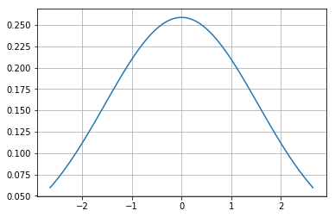
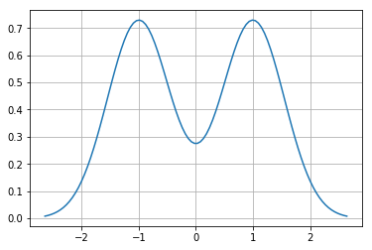
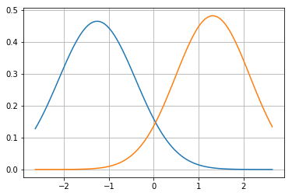
Data Encoding: Continuous Values
Continuous should be in [-1, 1] range, how do you rescale?
Has been done extensively in discriminative models. Try to avoid vanishing/exploding gradients by having mean 0, std 1.
What if the data is multimodal? → Gaussian Mixture Models

Slide 10
Data Encoding: Categorical values
In classifiers, success by using embeddings (i.e. class is represented by a trained vector).
Inverse transformation becomes very expensive. Requires distance measure which are often ambiguous in high dimensions.
Still often done using one-hot encoding

Slide 11
Data Encoding: Discrete values
Test data might have unseen or higher values than train data.
Some do it categorical, some continuous.
Effectiveness depends on the number of unique values. If large number of unique variables, approximate continuously

Slide 12
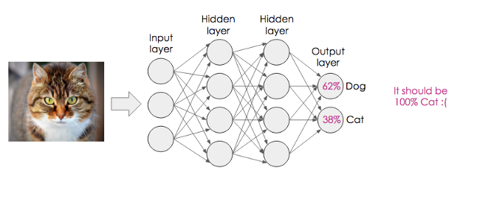
Neural Networks
Several layers that perform calculations
Can be thought of as a function f() with parameters φ, which are trained to map domain X to Y.
Results in one final layer, whose values can be trained to represent many things
Trained using backpropagation and gradient descent
If the network has many layers, this is often referred to as deep learning
Image from: https://medium.com/@RosieCampbell/demystifying-deep-neural-nets-efb726eae941

Slide 13
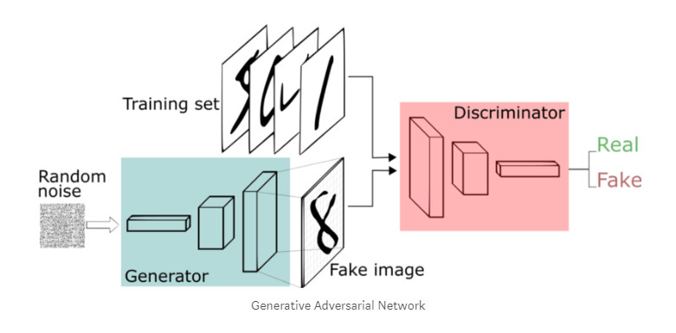
GANs in 5 minutes
Original GAN¹
Generator G tries to imitate real data
Discriminator D tries to distinguish fake from real
Minimax game between generator and Discriminator
Wasserstein GAN²
Uses 1-Wasserstein Distance
Bring logit distributions of last layer closer together
Less mode collapse
To enforce 1-Lipschitz constraint, clips critic weights to [-c, c]
WGAN-GP
Introduces gradient penalty instead of weight clipping
Converges better, faster training
1 Goodfellow, Ian, et al. "Generative adversarial nets." Advances in neural information processing systems. 2014.
2 Arjovsky, Martin, Soumith Chintala, and Léon Bottou. "Wasserstein gan." arXiv preprint arXiv:1701.07875 (2017).
.

Slide 14
Related Work

Slide 15
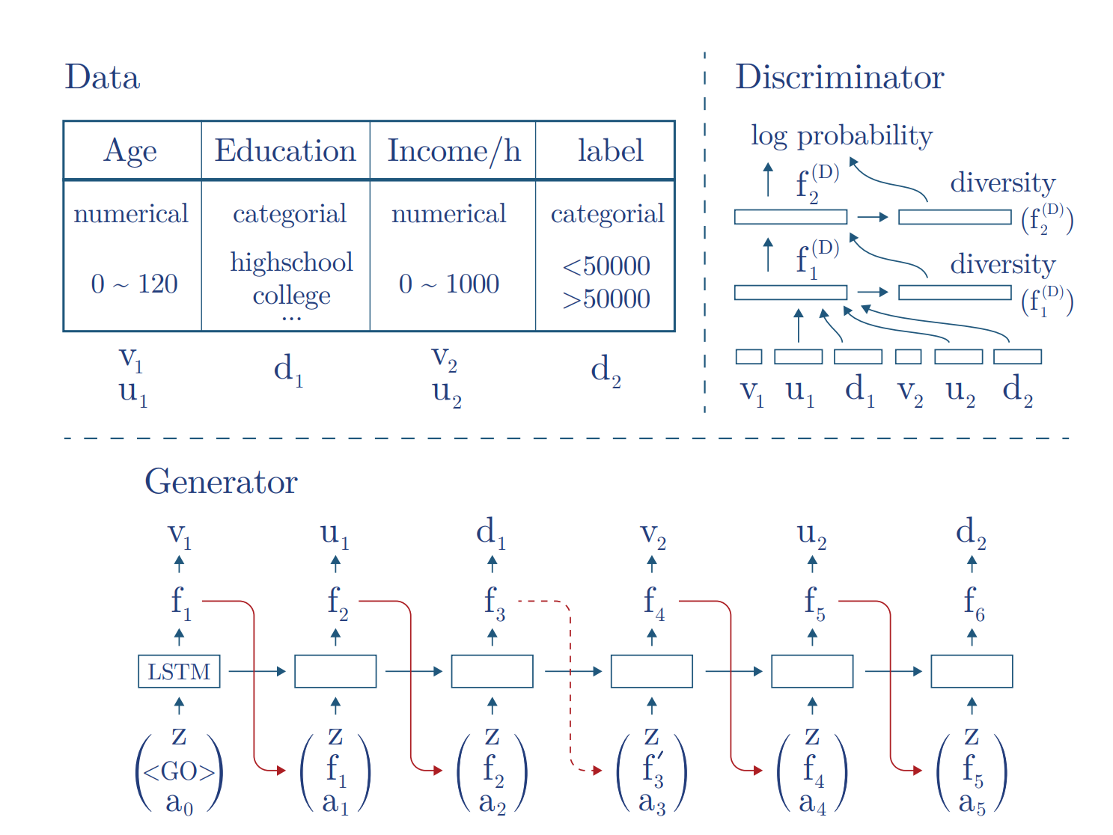
Related work 1: TGAN¹
Encodes continuous values with Gaussian Mixture Models.
Recurrent Neural Network
Has an attention mechanism
Problems:
Uses classic GAN Architecture
1 Xu, Lei, and Kalyan Veeramachaneni. "Synthesizing tabular data using generative adversarial networks." arXiv preprint arXiv:1811.11264 (2018).

Slide 16
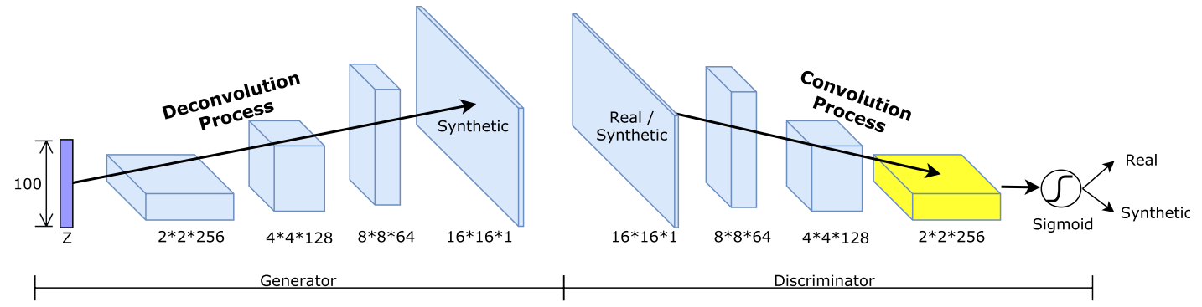
Related work 2: TableGAN¹
Uses DCGAN, SotA method for images
Handles ‘all’ datatypes
Has classifier, identical to the discriminator, for semantic coherence as third GAN part
Problems
Everything is represented as a float [0, 1]. Not ideal for discrete values.
Also uses classic GAN architecture
1 Park, Noseong, et al. "Data synthesis based on generative adversarial networks." Proceedings of the VLDB Endowment 11.10 (2018): 1071-1083.

Slide 17
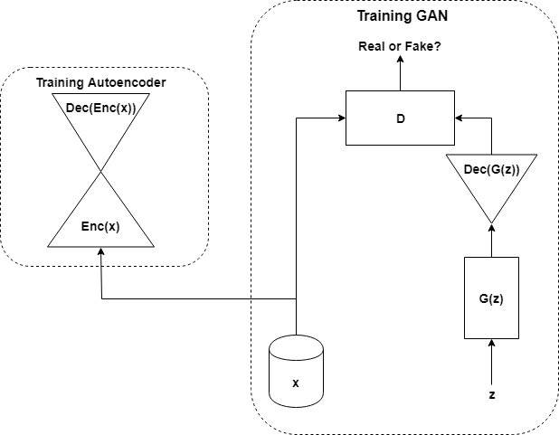
Related work 3: MedGAN¹
Autoencoders translates categorical features to continuous ones
Circumvent categorical features in the generator
Problems
Sampling autoencoder latent space is arbitrary for locations unseen during training
Original implementation does not work with multiple data types
1 Park, N., Mohammadi, M., Gorde, K., Jajodia, S., Park, H., & Kim, Y. (2018). Data synthesis based on generative adversarial networks. Proceedings of the VLDB Endowment, 11(10), 1071-1083.

Slide 18
Related work: Evaluations
Baselines are all over the place
Compared with data perturbation/anonymization tools sdcMicro, ARX
Statistical sampling techniques Gaussian Copula, Bayesian Networks
Neural approaches Boltzmann Machines, Variational autoencoders
Humans experts
Evaluation approaches differ:
Statistical evaluations
Privacy evaluations

Slide 19
Contributions

Slide 20
Contributions
Two improvements on the State of the Art model: TGAN
Improved evaluation metric for synthetic tabular data

Slide 21
Proposals
Use the WGAN-GP architecture
Add skip connections to the generator
An aggregate evaluation metric called the Similarity Score

Slide 22
Proposal 1: WGAN-GP architecture
Build upon TGAN to use the WGAN-GP architecture. This has shown improvements in visual domain with higher image fidelity and improved convergence.
Hypothesis: Model will converge faster and yield higher quality samples

Slide 23
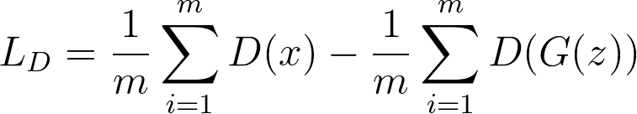
Proposal 1: WGAN-GP architecture
Adam optimizer parameter change to essentially become RMSProp (momentum=0)
Training discriminator more often than generator (5 times)
Output of discriminator no longer has sigmoid activation
Adapting loss function

Slide 24
Proposal 2: skip-connections
Skip connections have showed significant improvement in classifiers (most notable ResNets) but also GANs. Allows for greater retention of information and greater flow of gradients. Incorporate into the generator
Hypothesis: Model will converge faster. Will likely have higher quality images

Slide 25
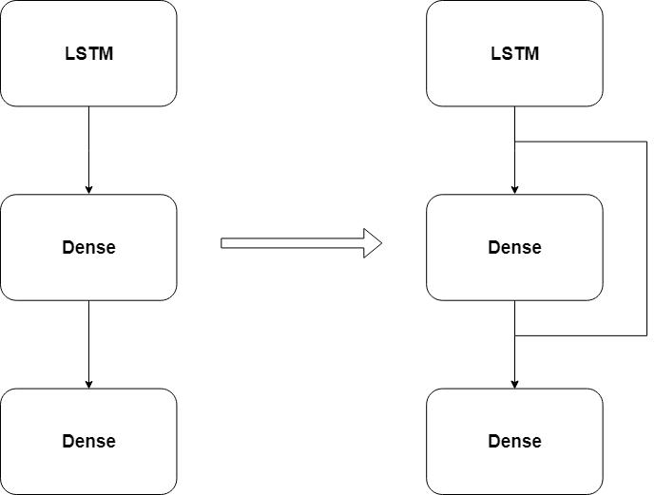
Proposal 2: skip-connections
Mathematically:
Visually
TGAN

Slide 26
Proposal 3: Similarity Score
Aggregate results from several metrics
Given a real and synthetic dataset
Correlation coefficient between basic statistical measures (mean, variance, etc.)
Correlation coefficient between the correlations of columns within a dataset
Correlations between column’s distributions between datasets
1 - MAPE of the variance top-5 PCA components
Machine learning efficacy
1 - MAPE for classifiers
Correlation coefficient for RMSE scores
Take the mean for the final Similarity Scores

Slide 27

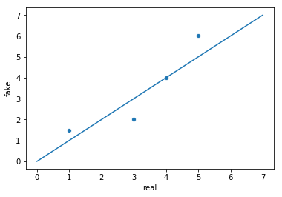
Proposal 3: Similarity Score 1. Basic statistical properties Correlation Are column distributions consistent?
 | Real | Fake
Mean Columns 1 | 5 | 6
Mean Column 2 | 3 | 2
Variance Column 1 | 4 | 4
Variance Column 2 | 1 | 1,5

Slide 28

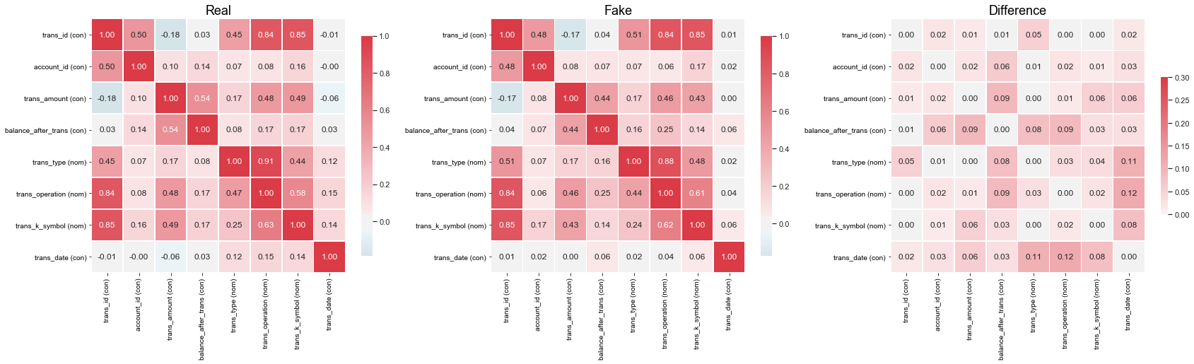
Proposal 3: Similarity Score 2. Column Correlations Correlation Are relations within the datasets consistent?

Slide 29

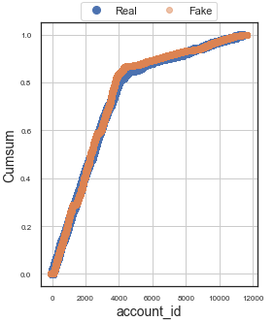
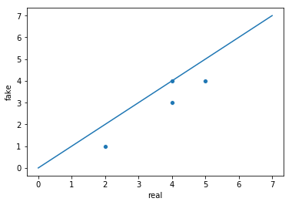
Proposal 3: Similarity Score 3. Mirror column Correlations Are relations between the datasets consistent?
Real Column x | Fake column x
2 | 1
4 | 3
4 | 4
5 | 4

Slide 30

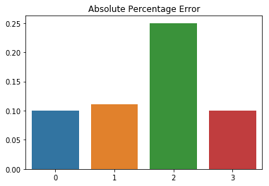
Proposal 3: Similarity Score 4. PCA Correlations Are the PCA explained variances similar?
Explained Variance
Component | Real | Fake
1 | 10000 | 11000
2 | 450 | 400
3 | 8 | 6
4 | 0.2 | 0.22

Slide 31

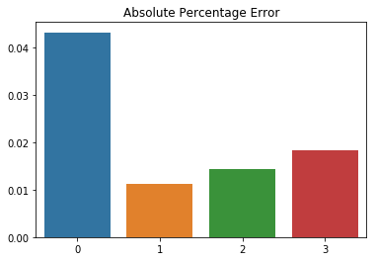
Proposal 3: Similarity Score 5. Machine learning Efficacy Is the performance on machine learning algorithms comparable?
Estimator scores
Trained on | Model | Real | Fake
Real | Random Forest | 0.768 | 0.735
 | Logistic Regression | 0.985 | 0.974
Fake | Random Forest | 0.712 | 0.725
 | Logistic Regression | 0.923 | 0.940

Slide 32
Proposal 3: Similarity Score Average all metrics

Slide 33
Data
Dataset | #Features | #D | #C | #rows | #labels
Berka | 8 | 4 | 4 | 1056320 | 3
Census | 40 | 33 | 7 | 199522 | 2
Creditcard | 30 | 1 | 29 | 248808 | 2

Slide 34
Results

Slide 35
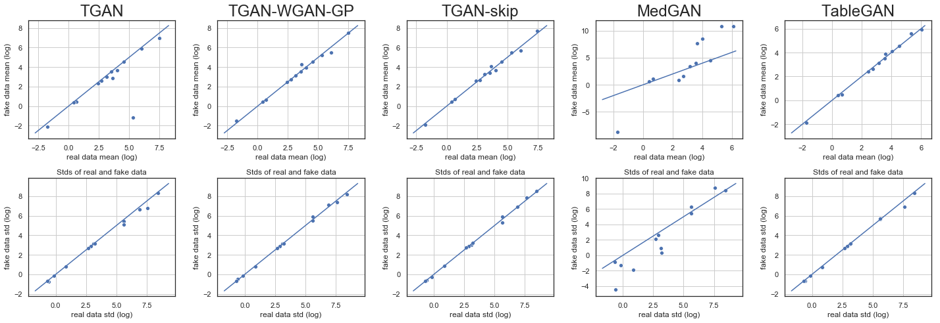
Results 1: Basic Statistics Correlations Correlation coefficient between means, median, std and variance
Dataset | TGAN | WGAN | SKIP | MedGAN | TableGAN
Berka | 0.9910 | 0.9955 | 0.9850 | 0.9115 | 0.9895
Census | 0.9212 | 0.9909 | 0.9894 | 0.4325 | 0.9947
Creditcard | 0.8028 | 0.8661 | 0.8799 | -0.0329 | 0.8734

Slide 36
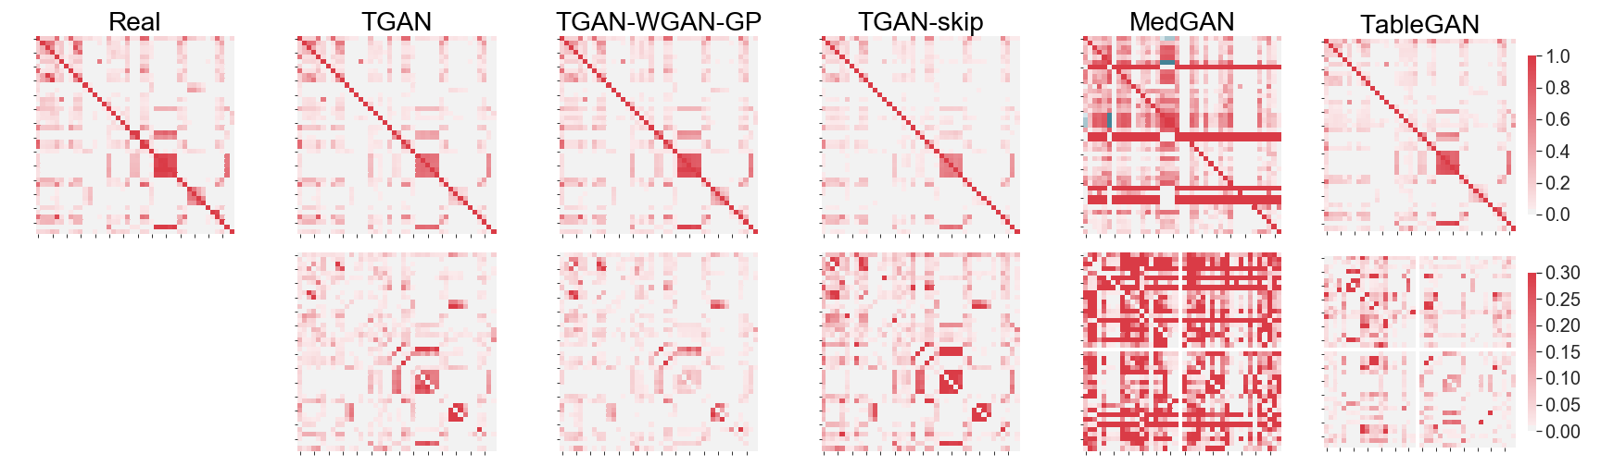
Results 2: Column Correlations Correlation coefficient between column correlations
Dataset | TGAN | WGAN | SKIP | MedGAN | TableGAN
Berka | 0.9821 | 0.9470 | 0.9832 | 0.7694 | 0.6468
Census | 0.9581 | 0.9773 | 0.9053 | 0.0644 | 0.9128
Creditcard | 0.0968 | 0.2932 | 0.2114 | -0.0471 | 0.2157

Slide 37
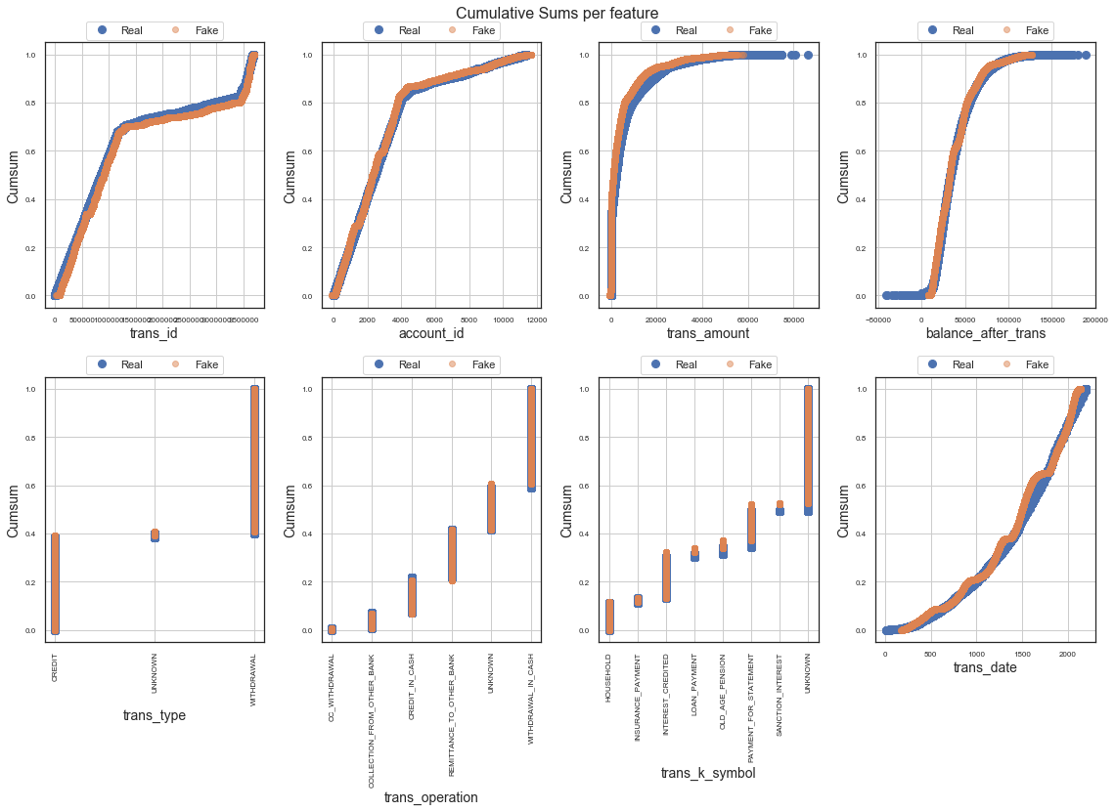
Results 3: Mirror Column Correlations Correlation coefficient between datasets
Dataset | TGAN | WGAN | SKIP | MedGAN | TableGAN
Berka | 0.9276 | 0.9150 | 0.9572 | 0.5602 | 0.8864
Census | 0.7008 | 0.8722 | 0.7941 | 0.2092 | 0.8651
Creditcard | 0.9215 | 0.9605 | 0.9342 | 0.7888 | 0.9425

Slide 38
Results 4: Estimator results 1 – MAPE(real F1, fake F1)
Dataset | TGAN | WGAN | SKIP | MedGAN | TableGAN
Berka | 0.9929 | 0.9807 | 0.9572 | 0.4168 | 0.8899
Census | 0.9854 | 0.9871 | 0.9840 | -292.1544 | 0.9673
Creditcard | 0.7999 | 0.9817 | 0.9712 | -0.8533 | 0.1696

Slide 39
Results 5: PCA Variance Correlation 1 – MAPE(Real Variance, Fake Variance)
Dataset | TGAN | WGAN | SKIP | MedGAN | TableGAN
Berka | 0.9456 | 0.9399 | 0.9424 | 0.8236 | 0.9465
Census | 0.9507 | 0.9739 | 0.9643 | 0.6907 | 0.9748
Creditcard | 0.8501 | 0.7810 | 0.7266 | 0.1726 | 0.8667

Slide 40
Results: Similarity scores
Dataset | TGAN | WGAN | SKIP | MedGAN | TableGAN
Berka | 0.9678 | 0.9556 | 0.9464 | 0.6963 | 0.8718
Census | 0.9032 | 0.9603 | 0.9274 | -58.1515 | 0.9429
Creditcard | 0.6942 | 0.7765 | 0.7447 | 0.0056 | 0.6136

Slide 41
Questions?

